Slide 1

Presented by Pranoy Roy
AtliQ Hardwares

Slide 2

About AtliQ Hardwares and Problem Statement
AtliQ Hardware, a leading hardware company specializing in PCs, printers, mice, and computers with a global reach.
The expanding size of Excel files has led to performance problems, resulting in unresponsiveness and inefficiency. AtliQ Hardware has launched a project to tackle this issue by assembling a team of data analysts. They will utilize MySQL as their database management system to extract meaningful insights from the data. These insights will empower the company to enhance decision-making and optimize operations, ultimately boosting overall performance.
AtliQ Hardwares
Presented by – Pranoy Roy

Slide 3
Project Overview
This project is designed to analyze and extract valuable insights from the provided database. The database contains information about sales, products, customers, and regions for Atliq Hardware. I aim to address specific questions related to sales reports, market analysis, customer behavior, and supply chain forecasting.
AtliQ Hardwares
Presented by – Pranoy Roy

Slide 4
AtliQ Hardware – Business Model
Customers Channels
Customer Platforms
Brick and Mortar
E-Commerce
Croma
Best Buy
Amazon
Flipkart
Customers
Croma
Best Buy
Staples
Flipkart
Retailer
Croma
Amazon
Direct
AtliQ E-store
AtliQ Exclusive
Neptune
AtliQ Hardwares
Presented by – Pranoy Roy

Slide 5
AtliQ Hardware – Business Model
Product Division
PC
N&S
P&A
Personal Laptop
Gaming Laptop
Wi-Fi Extenders
USB Flash Drives
Processor
Motherboard
Keyboard
Mouse
Product Segment
Storage
Peripherals
Notebook
Desktop
Accessories
AtliQ Hardwares
Presented by – Pranoy Roy

Slide 6
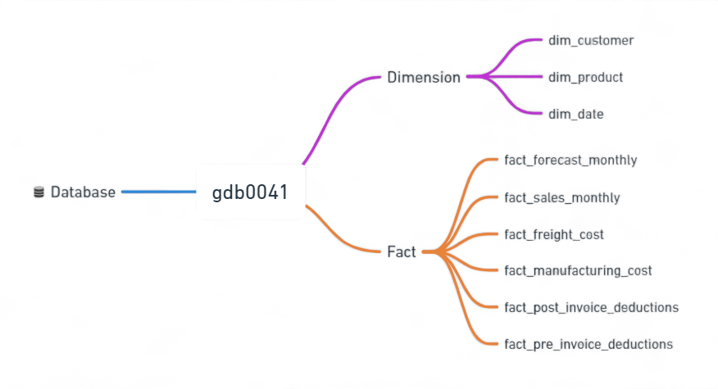
Data Sets
AtliQ Hardwares
Presented by – Pranoy Roy

Slide 7
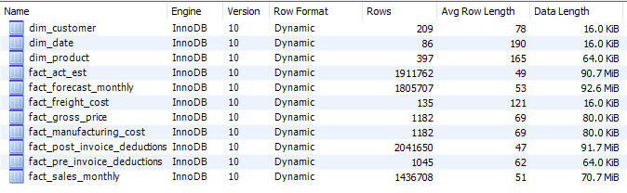
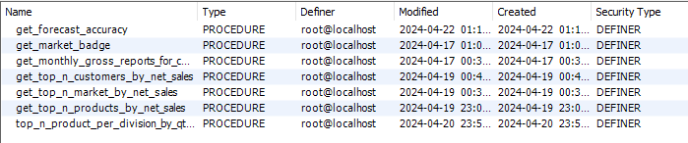

Database Overview
Tables
Stored Procedures
Functions
Views
AtliQ Hardwares
Presented by – Pranoy Roy

Slide 8
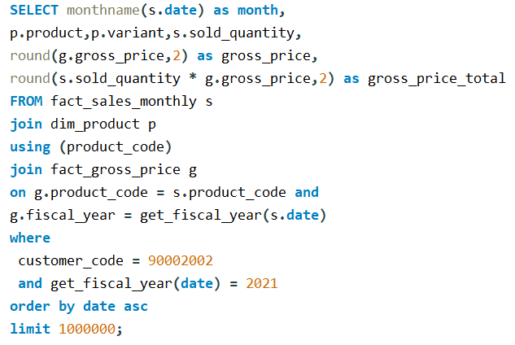
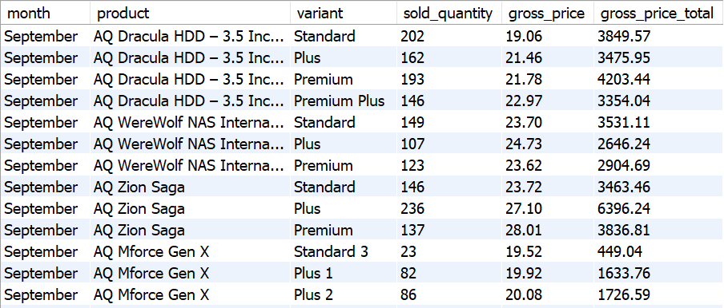
Croma India product wise sales report for fiscal year - 2021

Slide 9
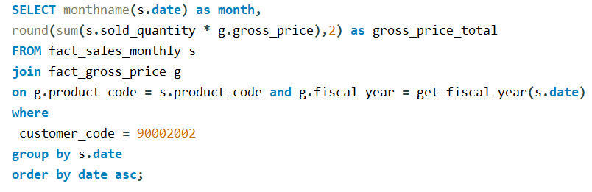
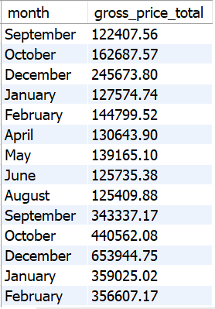
Gross monthly total sales for Croma
AtliQ Hardwares
Presented by – Pranoy Roy

Slide 10
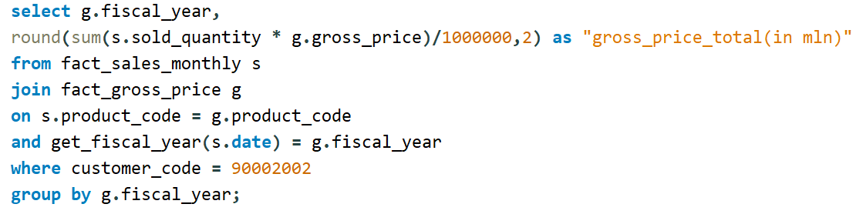
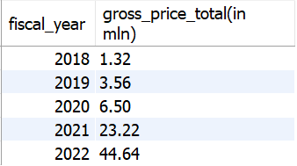
Yearly gross sales report for Croma India
AtliQ Hardwares
Presented by – Pranoy Roy

Slide 11
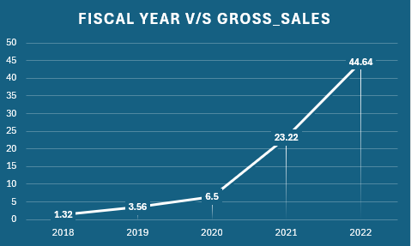
Yearly gross sales report for Croma India
AtliQ Hardwares
Presented by – Pranoy Roy

Slide 12
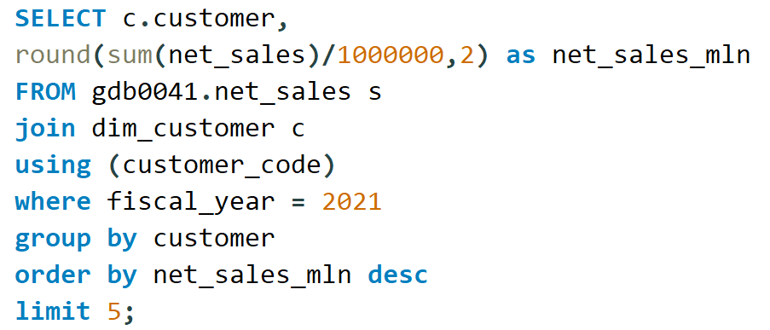
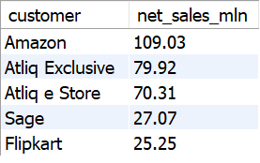
Top Market and Customers for a Financial Year 2021
Customer
AtliQ Hardwares
Presented by – Pranoy Roy

Slide 13
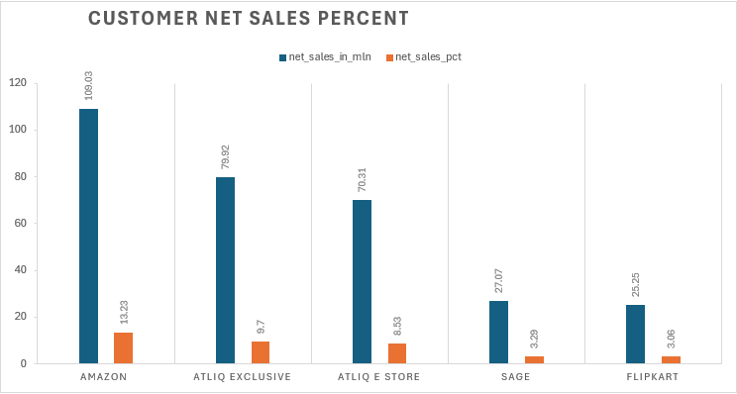
Top Market and Customers for a Financial Year 2021
Customer
AtliQ Hardwares
Presented by – Pranoy Roy

Slide 14
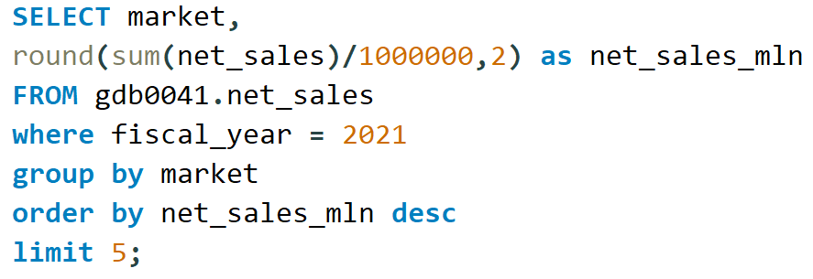
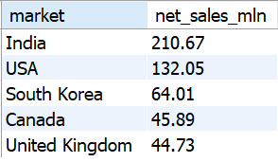
Top Market and Customers for a Financial Year 2021
Market
AtliQ Hardwares
Presented by – Pranoy Roy

Slide 15
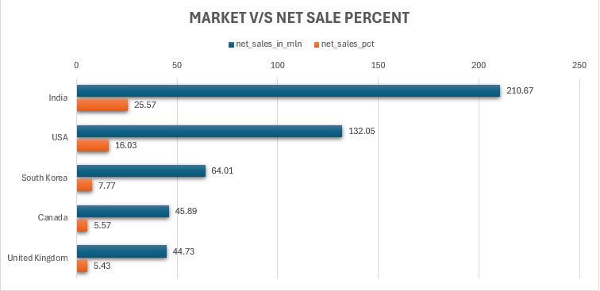
Top Market and Customers for a Financial Year 2021
Market
AtliQ Hardwares
Presented by – Pranoy Roy

Slide 16
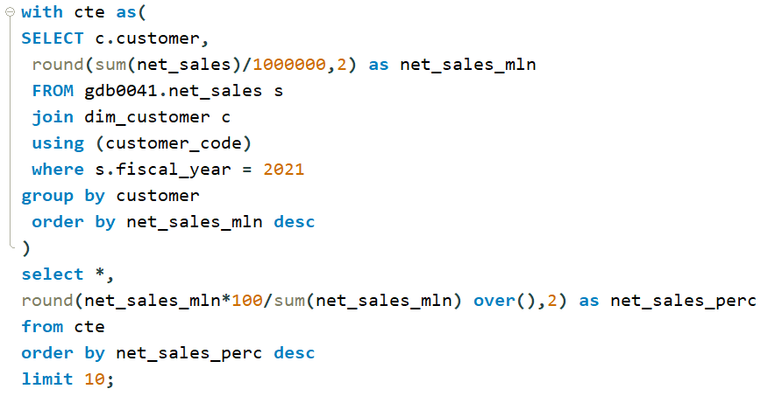
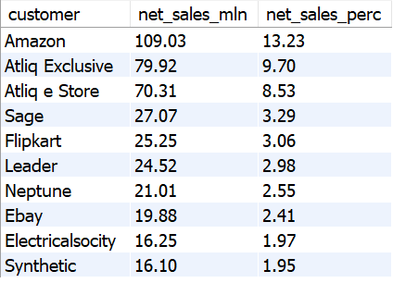
Net sales % share by Customers
AtliQ Hardwares
Presented by – Pranoy Roy

Slide 17
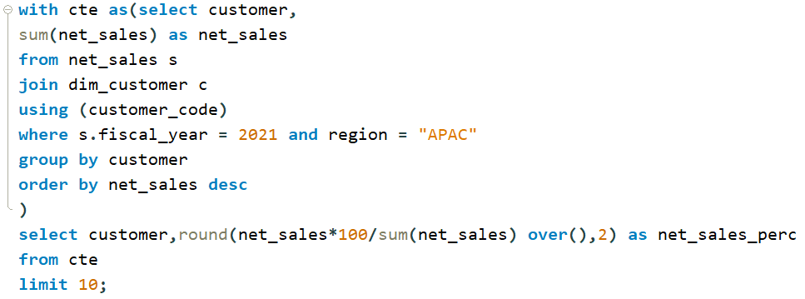
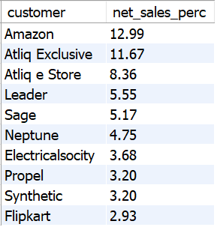
Net sales % share by Region - APAC
AtliQ Hardwares
Presented by – Pranoy Roy

Slide 18
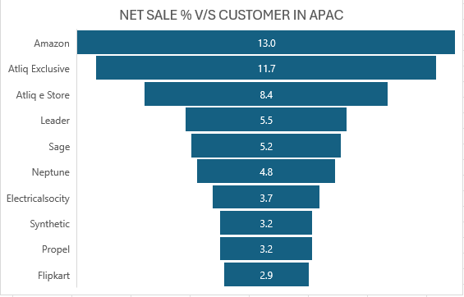
Net sales % share by Region - APAC
AtliQ Hardwares
Presented by – Pranoy Roy

Slide 19
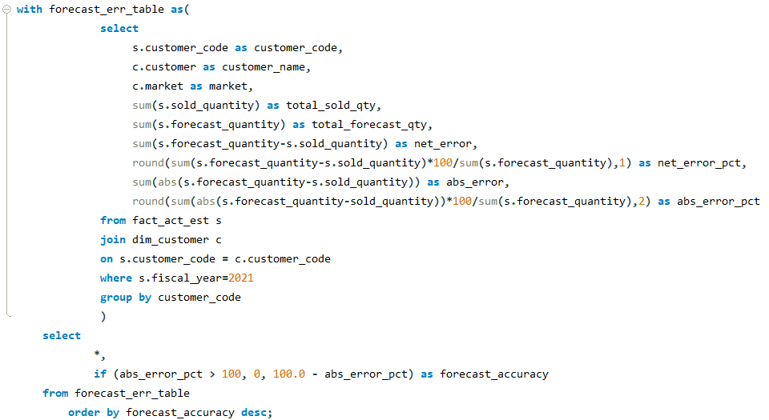
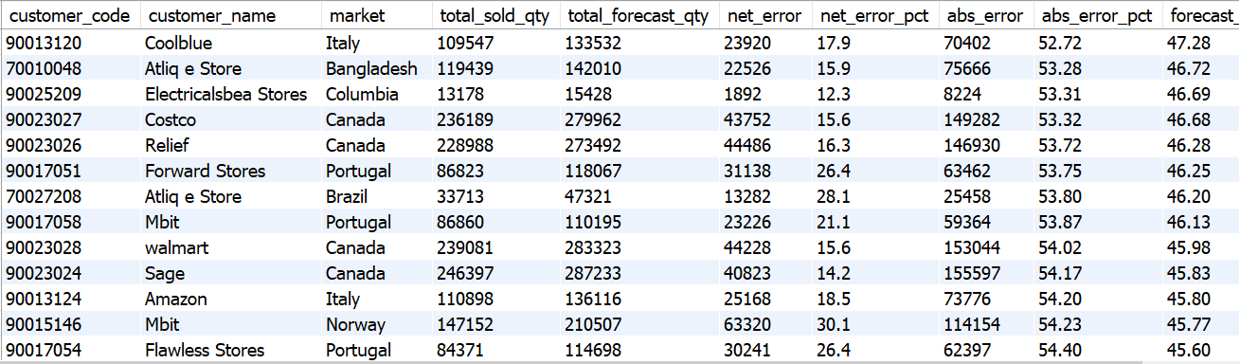
Supply Chain – Forecast Quantity
AtliQ Hardwares
Presented by – Pranoy Roy

Slide 20
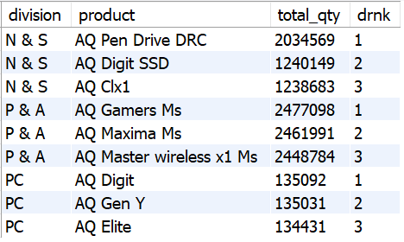
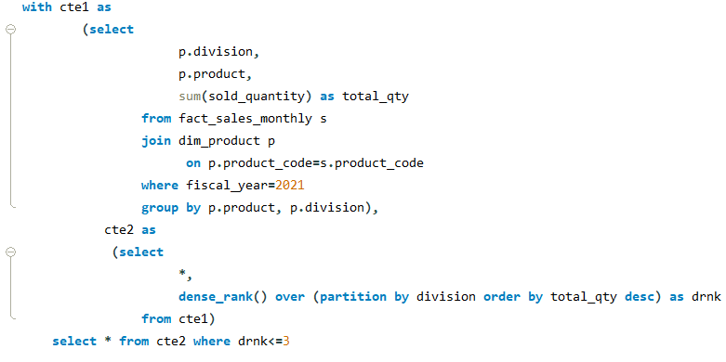
Top 3 products from each division by total quantity sold in a given year
AtliQ Hardwares
Presented by – Pranoy Roy

Slide 21
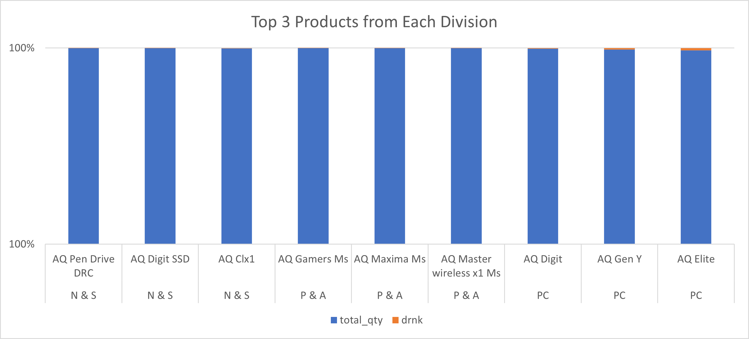
Top 3 products from each division by total quantity sold in a given year
AtliQ Hardwares
Presented by – Pranoy Roy

Slide 22
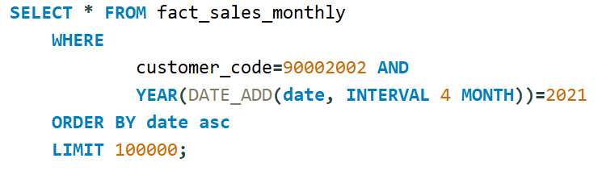
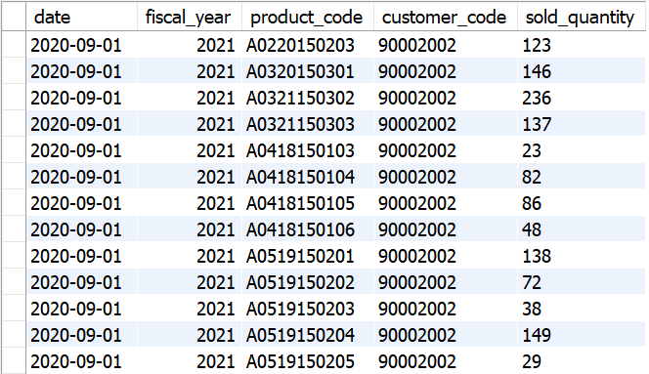
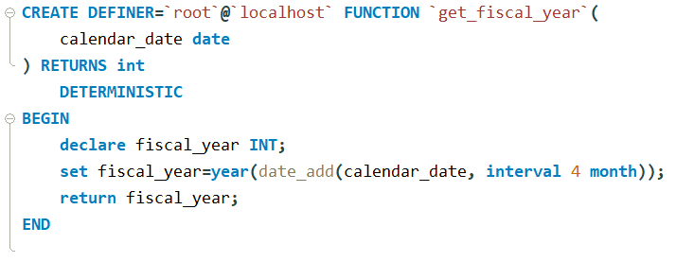
Get all the sales transaction data from fact_sales_monthly table for that customer(croma: 90002002) in the fiscal_year 2021
Create function for fiscal_year
AtliQ Hardwares
Presented by – Pranoy Roy

Slide 23
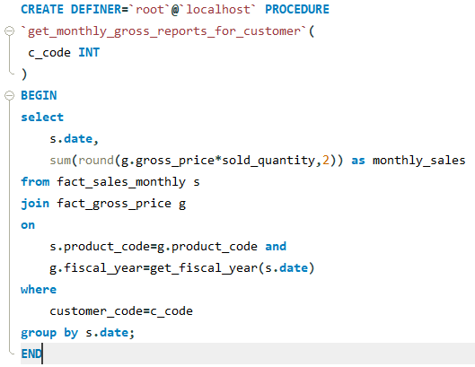
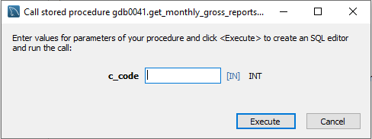
Generate monthly gross sales report for any customer using stored procedure
AtliQ Hardwares
Presented by – Pranoy Roy

Slide 24
Key Insights
Net sales of Amazon is highest with 109.03M in fiscal year 2021 followed by AtliQ Exclusive with 79.92M.
Market in India generated maximum net sales with 210.67M in fiscal year 2021 followed by USA with 132.05M.
Amazon generated 13.23% of total net sales among all customers in fiscal year 2021.
In APAC region, Amazon contributed maximum net sales % of 12,99% among rest customers in 2021.
In APAC, region India ranks 1 in terms of total gross sales.
AtliQ Hardwares
Presented by – Pranoy Roy

Slide 25
Thank You
AtliQ Hardwares
Presented by – Pranoy Roy

